Slide 1


Slide 2
TIME MANAGEMENT
VIGNAN’S UNIVERSITY

Slide 3
HOW DO WE SPEND OUR TIME?
Sleep | 22 years
Daily routine- | 2.5 years
Meals | 5.5 years
Commuting | 5.5 years
Work | 16 years (including unproductive work, gossip etc.)
Miscellaneous | 2.5 years
Personal discretion | 11 years
Total | 65 years

Slide 4
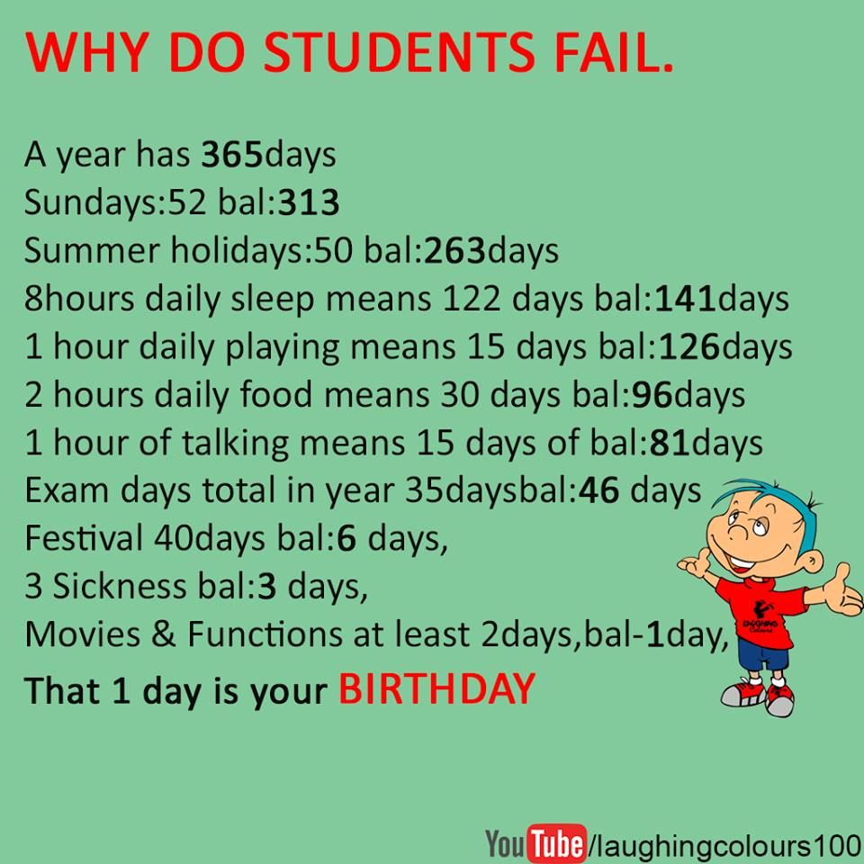

Slide 5
TIME MANAGEMENT
The art of arranging, organizing, scheduling and budgeting one’s time for the purpose of generating more effective work and productivity is known Time Management.

Slide 6
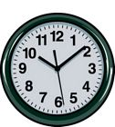
Need of TM
Helps to take rapid action when opportunities and crisis arise
Helps to give a defined and organized structure to one’s days and weeks
Helps to save time
Helps to perform and fulfill all important activities
Helps to plan all tasks effectively
Helps in setting the goals

Slide 7
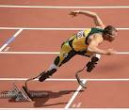
VALUE OF TIME
To realize the value of one year
Ask a student who failed a grade
To realize the value of one month
Ask a mother who gave birth to a premature baby
To realize the value one week
Ask the editor of a weekly newspaper
To realize the value of one hour
Ask the lovers who are waiting to meet

Slide 8
THE VALUE OF TIME
To realize the value of one minute
Ask person who missed the train
To realize the value of one second
Ask a person who just avoided an accident
To realize the value of fraction of a second
Ask the person who won a silver medal in the Olympics.

Slide 9


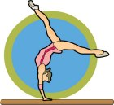
Distribute your time Between
Tighter side of life Lighter side of life
Discipline, Fun,
Strict routines, Jokes,
timely food, Humor
sleep,
punctuality
Brighter side of life
Learning,
thinking,
Reading Have a Balance

Slide 10
Pareto’s Principle (80/20 Rule)
80% of Work gives 20% Results & 20% of Work gives 80% Results
One Rs.500/- v/s Hundred Rs.5/-
Effective v/s Efficient
Smart work v/s Hard work

Slide 11
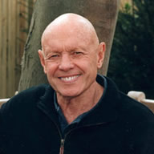
For true success and meaning in life, we must be principle-centered in all areas of life.
“There are three constants in life:
change, choice and principles.“
Dr.Stephen R.Covey
Author 7 Habits of
Highly effective people

Slide 12
Stephen Covey’s Time Management Matrix
Urgent
Not Urgent
I
II
. Crisis
. Pressing problems
. Deadline-driven projects, meetings, preparations
. Preparation
. Prevention
. Values clarification
. Planning
. Relationship building
. True re-creation
. Empowerment
Important
III
IV
. Interruptions, some
phone calls
. Some mail, some reports
. Some meetings
. Many proximate,
pressing matters
. Many popular activities
. Trivia, busywork
. Some phone calls
. Time wasters
. “Escape” activities
. Irrelevant mail
. Excessive TV
Not Important

Slide 13
Quadrant I
Represents things that are both “urgent” and “important” – we need to spend time here
This is where we manage, we produce, where we bring our experience and judgment to bear in responding to many needs and challenges.
Many important activities become urgent through procrastination, or because we don’t do enough prevention and planning

Slide 14
Quadrant II
Includes activities that are “important, but not urgent”- Quadrant of Quality
Here’s where we do our long-range planning, anticipate and prevent problems, empower others, broaden our minds and increase our skills
Ignoring this Quadrant feeds and enlarges Quadrant I, creating stress, burnout, and deeper crises for the person consumed by it
Investing in this Quadrant shrinks Quadrant I

Slide 15
Quadrant III
Includes things that are “urgent, but not important” - Quadrant of Deception.
The noise of urgency creates the illusion of importance.
Actual activities, if they’re important at all, are important to someone else.
Many phone calls, meetings and drop-in visitors fall into this category
You can delegate for some activities

Slide 16
Quadrant IV
Reserved for activities that are “not urgent, not important”- Quadrant of Waste
We often “escape” to Quadrant IV for survival
Reading addictive novels, watching mindless television shows, or gossiping at office would qualify as Quadrant IV time-wasters

Slide 17
List of things contribute to TM
Prioritization,
Concentration and focus,
Scheduling,
Goal setting and
Self-motivation

Slide 18
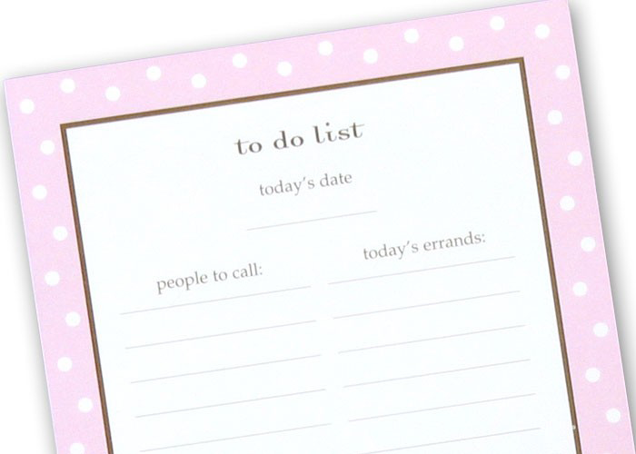
Creating a “to do” list
The benefit of making to do list is that you do not have to remember the things that you want to do Today , so you can move mind free to concentrate and to know exactly what you want to do today.

Slide 19
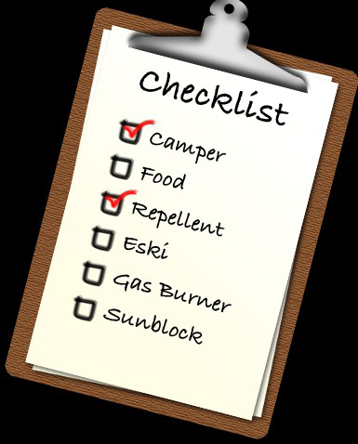
Use check list
For every task you will need a check list before to start that you are capable to that job and have all the items to start that
particular task.

Slide 20
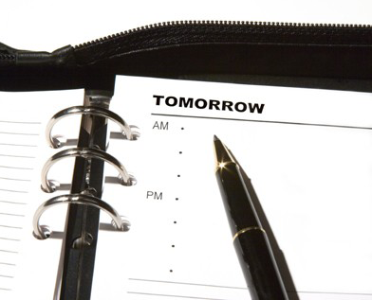

Plan Ahead
Plan your tomorrows work today so that you have plenty of time to gather and prepare the material for the next task.
Doing this helps us to sleep better.

Slide 21
Telephone abuse
Phone has turned to be the biggest time waster of all. The danger lies in over use.
How much time you are spending on phone? It breaks your train of thought and your work flow.

Slide 22
To Do List
Activities to be done (in order of priority) | Time of day From To
1.
2.
3.
4.
5.
6.
7.
8.

Slide 23
Time wasters | Strategies to overcome

Slide 24
Time Table
ACTIVITY | TIME
Prayer, Meditation, | According to your age
Physical, energizing Exercise | 40 minutes
Reading educative books | Two hours of studying for every one credit hour of the class
Work in institution
Socializing, listening music, entertainment
Watching T.V
Introspection at the end of the day

Slide 25
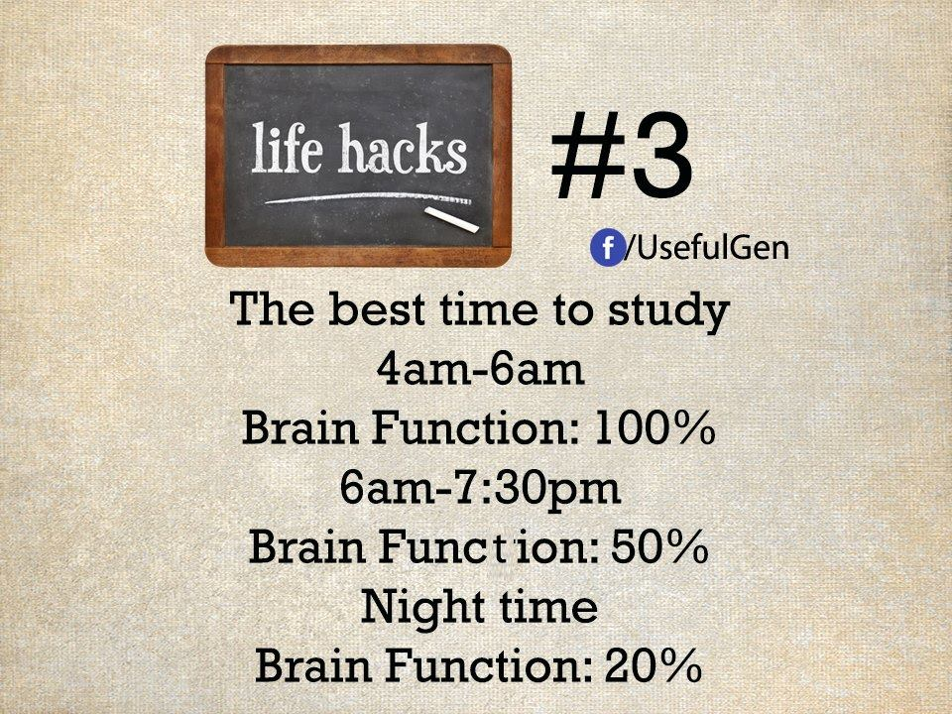

Slide 26
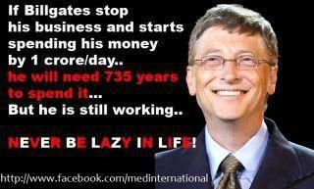
DISCIPLINE

Slide 27
TIME:
That man is always trying to kill,
But
Which ends killing him
Time and tide waits for none-
Make use of it well
All the best

